Slide 1
Cross Platform Application Development Assignment 1
Submitted by
Satish Kumar Sharma(2022MT93327)

Slide 2
Assignment1
Writing an app that needs to persist and query large amounts of data on the local device, consider using a database instead of a local file or key-value store. In general, databases provide faster inserts, updates, and queries compared to other local persistence solutions. Flutter apps can make use of the SQLite databases via the sqflite plugin available on pub.dev. Create an application to do basics using sqflite to insert, read, update, and remove data about various Persons.
If you are new to SQLite and SQL statements, review the SQLite Tutorial to learn the basics before completing this recipe.
Creating a Database experience in a Flutter app for both iOS and Android.

Slide 3
Application demo and Source Code link
Android App Demo link: https://www.youtube.com/watch?v=xDZd-Iwhm_Y
iOS App Demo Link: https://youtu.be/jOjitJdfrT4
Code uploaded on My GitHub Link: : https://github.com/iamsatishsharma/flutter_curd
Source Code attached in MS word file as well in Zip.

Slide 4
Step to Setup Flutter in Android Studio
Install and setup Android Studio (https://docs.flutter.dev/get-started/editor?tab=androidstudio).
Add and update the SDK, Set path.
Add sqflite Plugin in android studio.
Add Flutter Plugin in Android studio.
Create a Emulator device in Android Studio
Create a Flutter project
Make sure to add dependency flutter and sqflite in pubspec.yaml.
Start working on application, start to write SQLHelper to perform CURD operations.
Design the User interface to interact with user to take input from user.

Slide 5
Steps to create DB and CURD Method
I am using the following steps:
Installed Android studio for Android and XCode for iOS
Installed Flutter
Add the dependencies.
Create a Database.
Define the person data model.
Open the database.
Create the persondetails table.
Insert a person into the database.
Retrieve the list of persons.
Update a person in the database.
Delete a person from the database.
Note: Code has been added in MS Doc file in zip folder.

Slide 6
Steps Flutter and SQLite
Flutter is a mobile app SDK for building high-performance, high-fidelity, apps for iOS and Android. Flutter works with existing code, is used by developers and organizations around the world, and is free and open source.
SQLite database is a lightweight embedded database. Its database is a file. SQLite is commonly used by mobile devices, small and medium-size traffic websites for version conversion systems, financial analysis tools, media cataloging, and editing suites, record keeping programs, and so forth.
Flutter apps can make use of the SQLite databases via the sqflite plugin available on pub.dev.

Slide 7
Android : Screenshots – Create and Read
1st screen
show the basic validation. Validation error display in red color.
1st screen has two section. 1st half has use to create and update the person
Details and 2nd half screen use to fetch And display the person list.
Those list data fetch from the SQLite DB.
2nd Screen
Shows the list of record created and saved in SQLite DB and fetch from the local DB.
List view having edit and delete button to modify and delete the record.

Slide 8
Android: Screenshots - Update
Updated 1st row details in list
Old Details:-
Name: Satish
Age: 34
Address: Dubai
Updated Details:-
Name: Jack
Age: 37
Address: Dubai

Slide 9
Android: Screenshots - Delete
In This screen, I have deleted few items and added few new items.
Android Assignment Demo link:
https://www.youtube.com/watch?v=xDZd-Iwhm_Y
iOS Demo Link:
https://youtu.be/jOjitJdfrT4
Source code on My GitHub : https://github.com/iamsatishsharma/flutter_curd

Slide 10
Setup for XCode for iOS Application Development
Project Structure:
flutter_curd/
├── .ios/
│ ├── Runner.xcworkspace
│ └── Flutter/podhelper.rb
├── lib/
│ └── main.dart
├── test/
└── pubspec.yaml
Integrate a Flutter module into your iOS project
iOS setup
Install Xcode
sudo xcode-select --switch /Applications/Xcode.app/Contents/Developer
sudo xcodebuild -runFirstLaunch
Build and execute project:
Set up the iOS simulator
open -a Simulator
Create and run a simple Flutter app
flutter create flutter_curd
cd flutter_curd
flutter run
Deploy to iOS devices
Add Flutter plugins
sudo gem install cocoapods
Follow the XCode signing flow to provision your project:
pod update

Slide 11
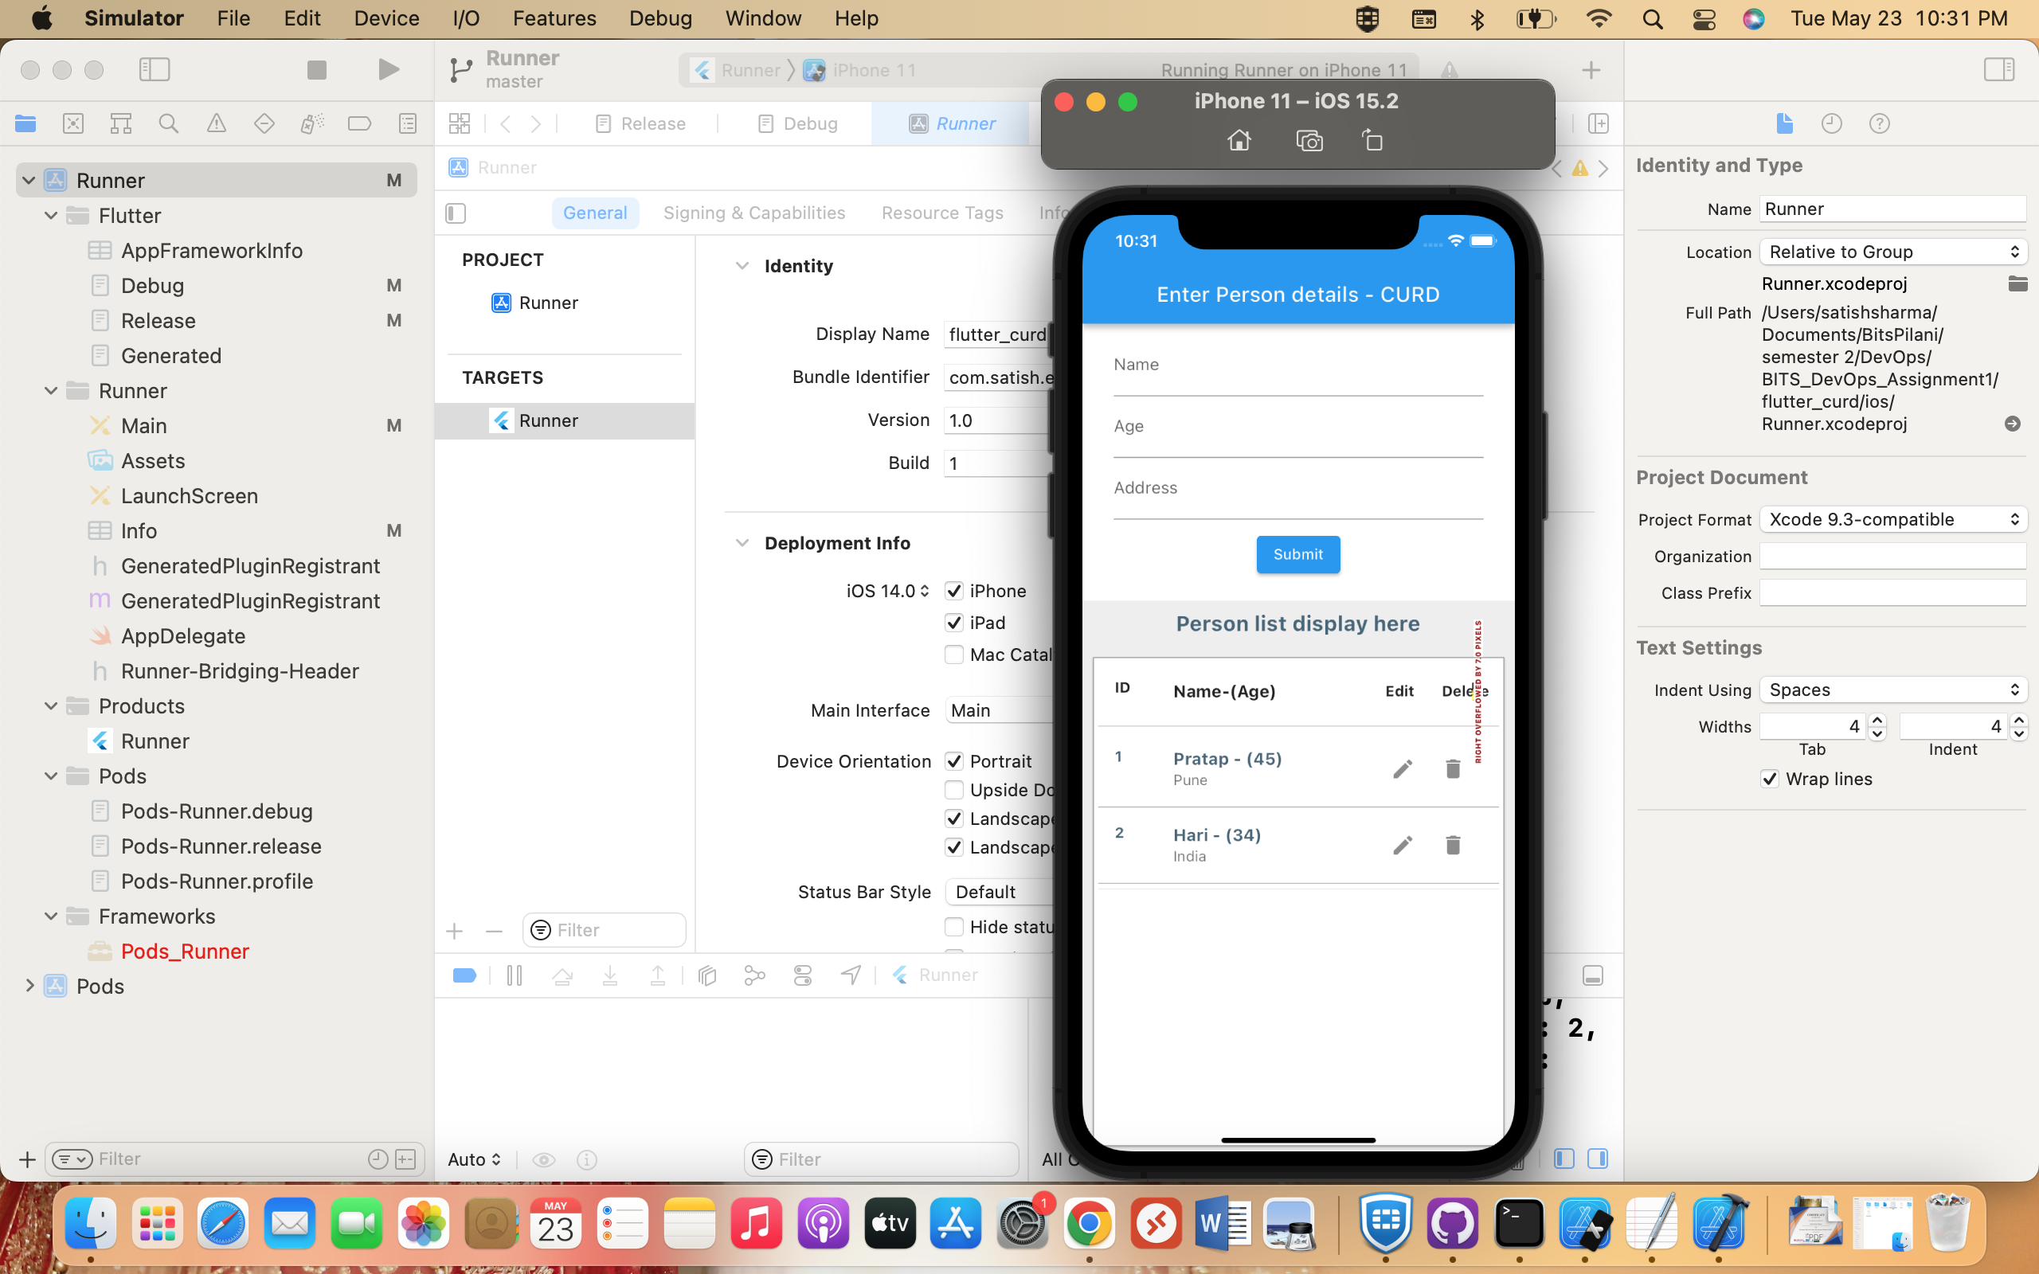
iOS – XCode setup Screenshot

Slide 12
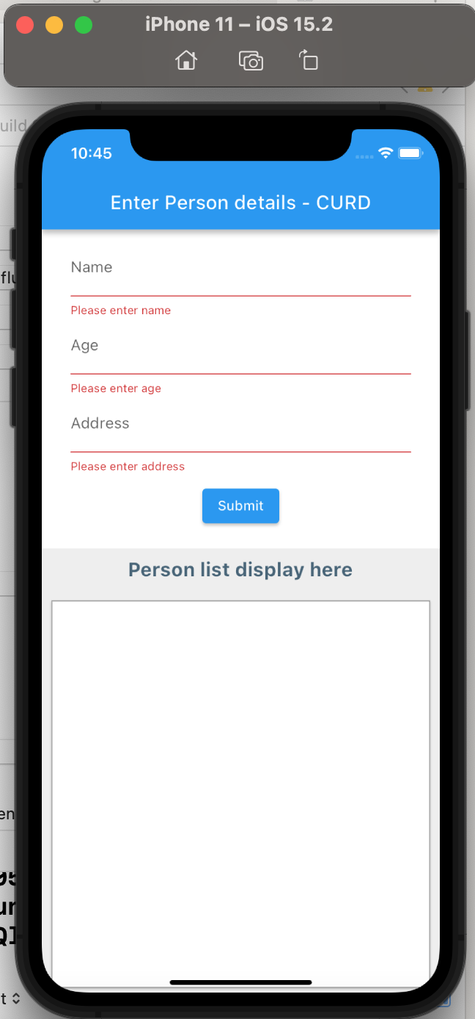
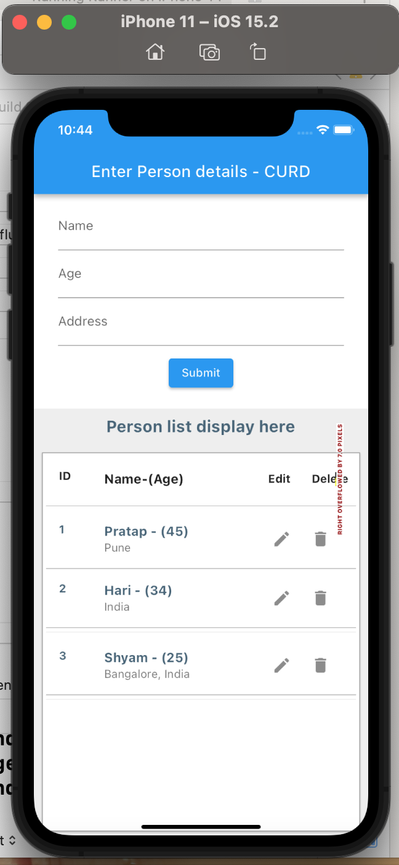
XCode iOS : Screenshots – Create, Read and update
1st screen
show the basic validation. Validation error display in red color.
1st screen has two section. 1st half has use to create and update the person
Details and 2nd half screen use to fetch And display the person list.
Those list data fetch from the SQLite DB.
2nd Screen
Shows the list of record created and saved in SQLite DB and fetch from the local DB.
List view having edit and delete button to modify and delete the record.

Slide 13
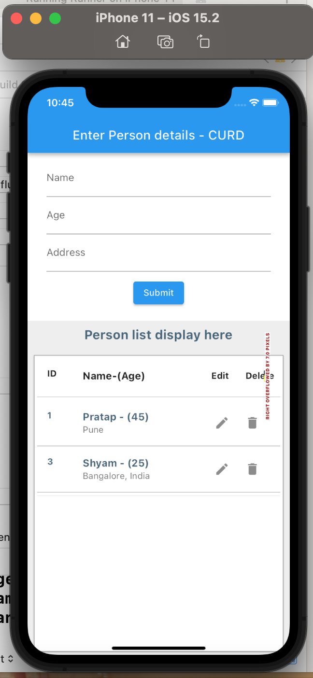
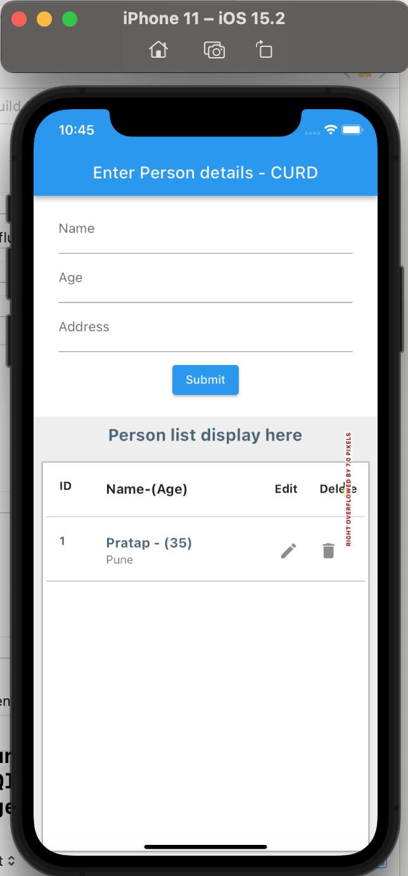
XCode iOS : Screenshots – Delete
1st screen
Display two record that fetch from the local DB.
2nd Screen
Updated 1st row details in list
Updated age Details from 45 to 35.
Name: Pratap
Age: 35
Address: Pune
Deleted 2nd row:
Name: Shyam,
Age: 25
Address: Bangalore, India

Slide 14
Key learnings
I have learned how to set up Android Studio and install the necessary software tools.
I have learned how to set up XCode for iOS development and install the necessary software tools (Flutter, pods).
I have also learned how to add flutter plugin, dependencies and create a SQLite database.
Additionally, I have gained the knowledge to design screens using Dart language in Flutter. Furthermore, I have learned how to connect the database to mobile screens and perform operations such as create, update, read, and delete data.
Android Demo link: https://www.youtube.com/watch?v=xDZd-Iwhm_Y
iOS Demo Link: https://youtu.be/jOjitJdfrT4
My GitHub Code Link: : https://github.com/iamsatishsharma/flutter_curd

Slide 15
Thank You

